Slide 1

ENG 098: Lecture On Identifying and Creating the Main Ideas and Support in Writing
Week 4 Lecture on Common Ground from Chapter 10

Slide 2
On the Purposes of a Text
To inform- For example, the main idea or purpose is the focus of the entire essay. Nothing in the essay strays from this main idea. For example, the main idea of an essay may be about the benefits of exercise. (Hoffner & Hoeffner 197)
To analyze-To explain or describe parts of something. For instance, identifying and describing the benefits of exercise, such as lowered cholesterol, lowered risk for diabetes, and lowered risk for myocarditis are all examples of analysis. The “how” and “why” are essential.
To evaluate- provide value statements or judgments of the value or worth of an idea or a value. Evaluating whether the positive effects of exercise outweighs the bad (possible injury, electrolyte imbalance from overexertion, etc.) would be an example of evaluation.
To persuade-to get the readers to agree with your stance. By focusing on examples of why exercise outweighs the bad and for what reasons, works to convince the reader to consider your stance. To present an unbiased argument, you should acknowledge and refute an opposing view to allow your reader to decide what to believe for themselves. Your goal is to persuade them with convincing arguments, evidence, and examples.

Slide 3
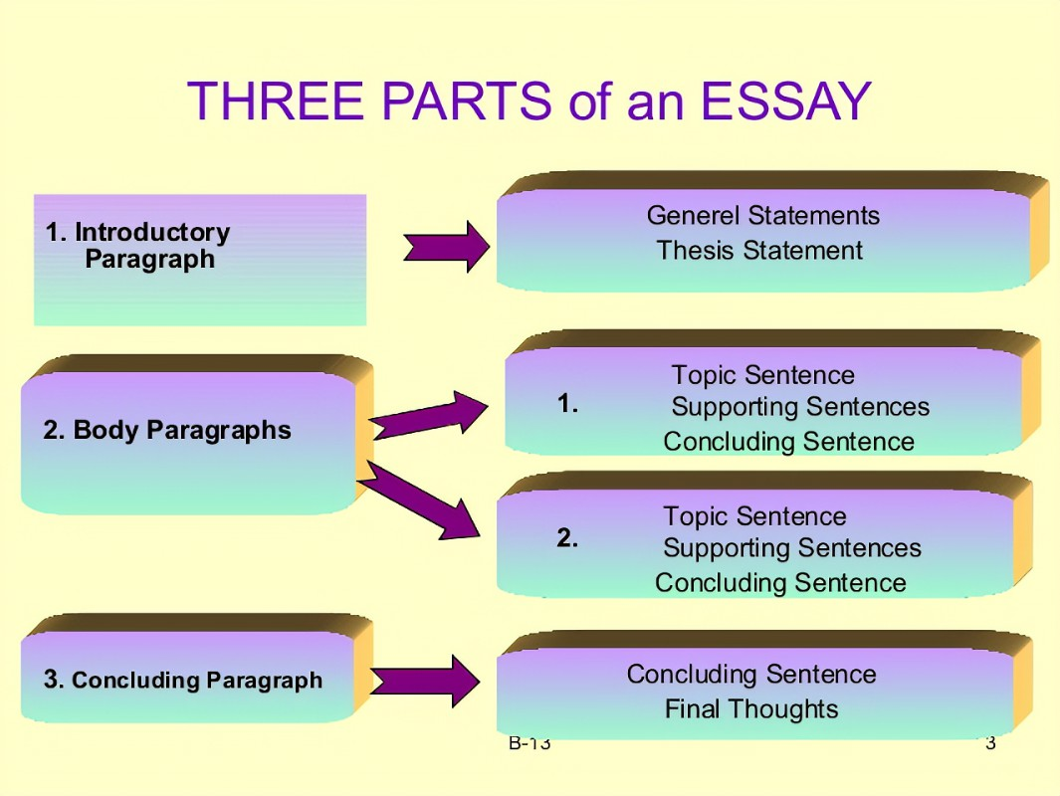
Parts of an Essay

Slide 4
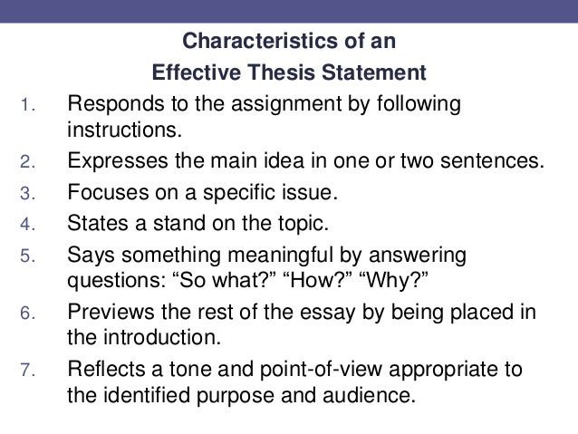
Traits of an Effective Thesis

Slide 5
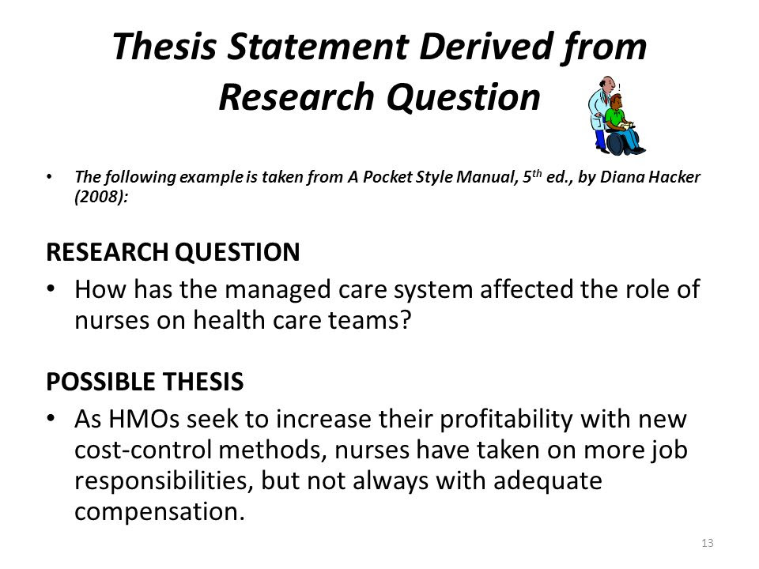
How to Write a Research Question

Slide 6
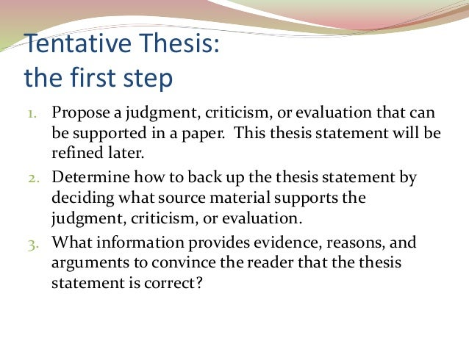
Tentative Thesis:

Slide 7
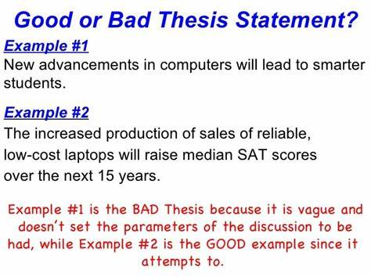
A Good Final Thesis Vs. A Bad Final Thesis

Slide 8
Video on How to Write an Effective Thesis
https://youtu.be/DFp1uGTXo4Q

Slide 9
Interactive Video Questions
What does the thesis statement do?
How many sentences is the thesis statement?
Where does it appear?
Can you stay on topic with the thesis?
What three things does the thesis accomplish?
What is a research question?
How do you develop a tentative thesis?
Brexit was driven by political frustration is an example of what type of thesis?
What does the final thesis do?
The Brexit frustration was caused by working class frustration and political elite is an example of what type of thesis?
What is an argumentative, expository, or analytical thesis?

Slide 10
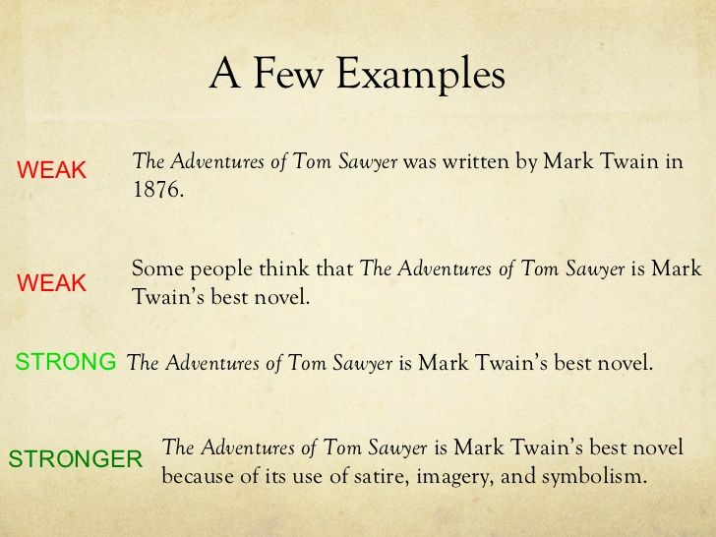
Examples of a Good Thesis (Specific Topic) Vs. a Weak Thesis (Not Specific-Broad Topic)
A poor thesis statement is one that is a general fact, that is too broad, or simply presents generalities. A good thesis focuses on answering a specific question about a topic from an original point of view.

Slide 11
Where is the Main Idea in a Paragraph and an Essay?
The thesis is the main idea in an essay.
In an essay, the main idea is found in the topic sentence.

Slide 12
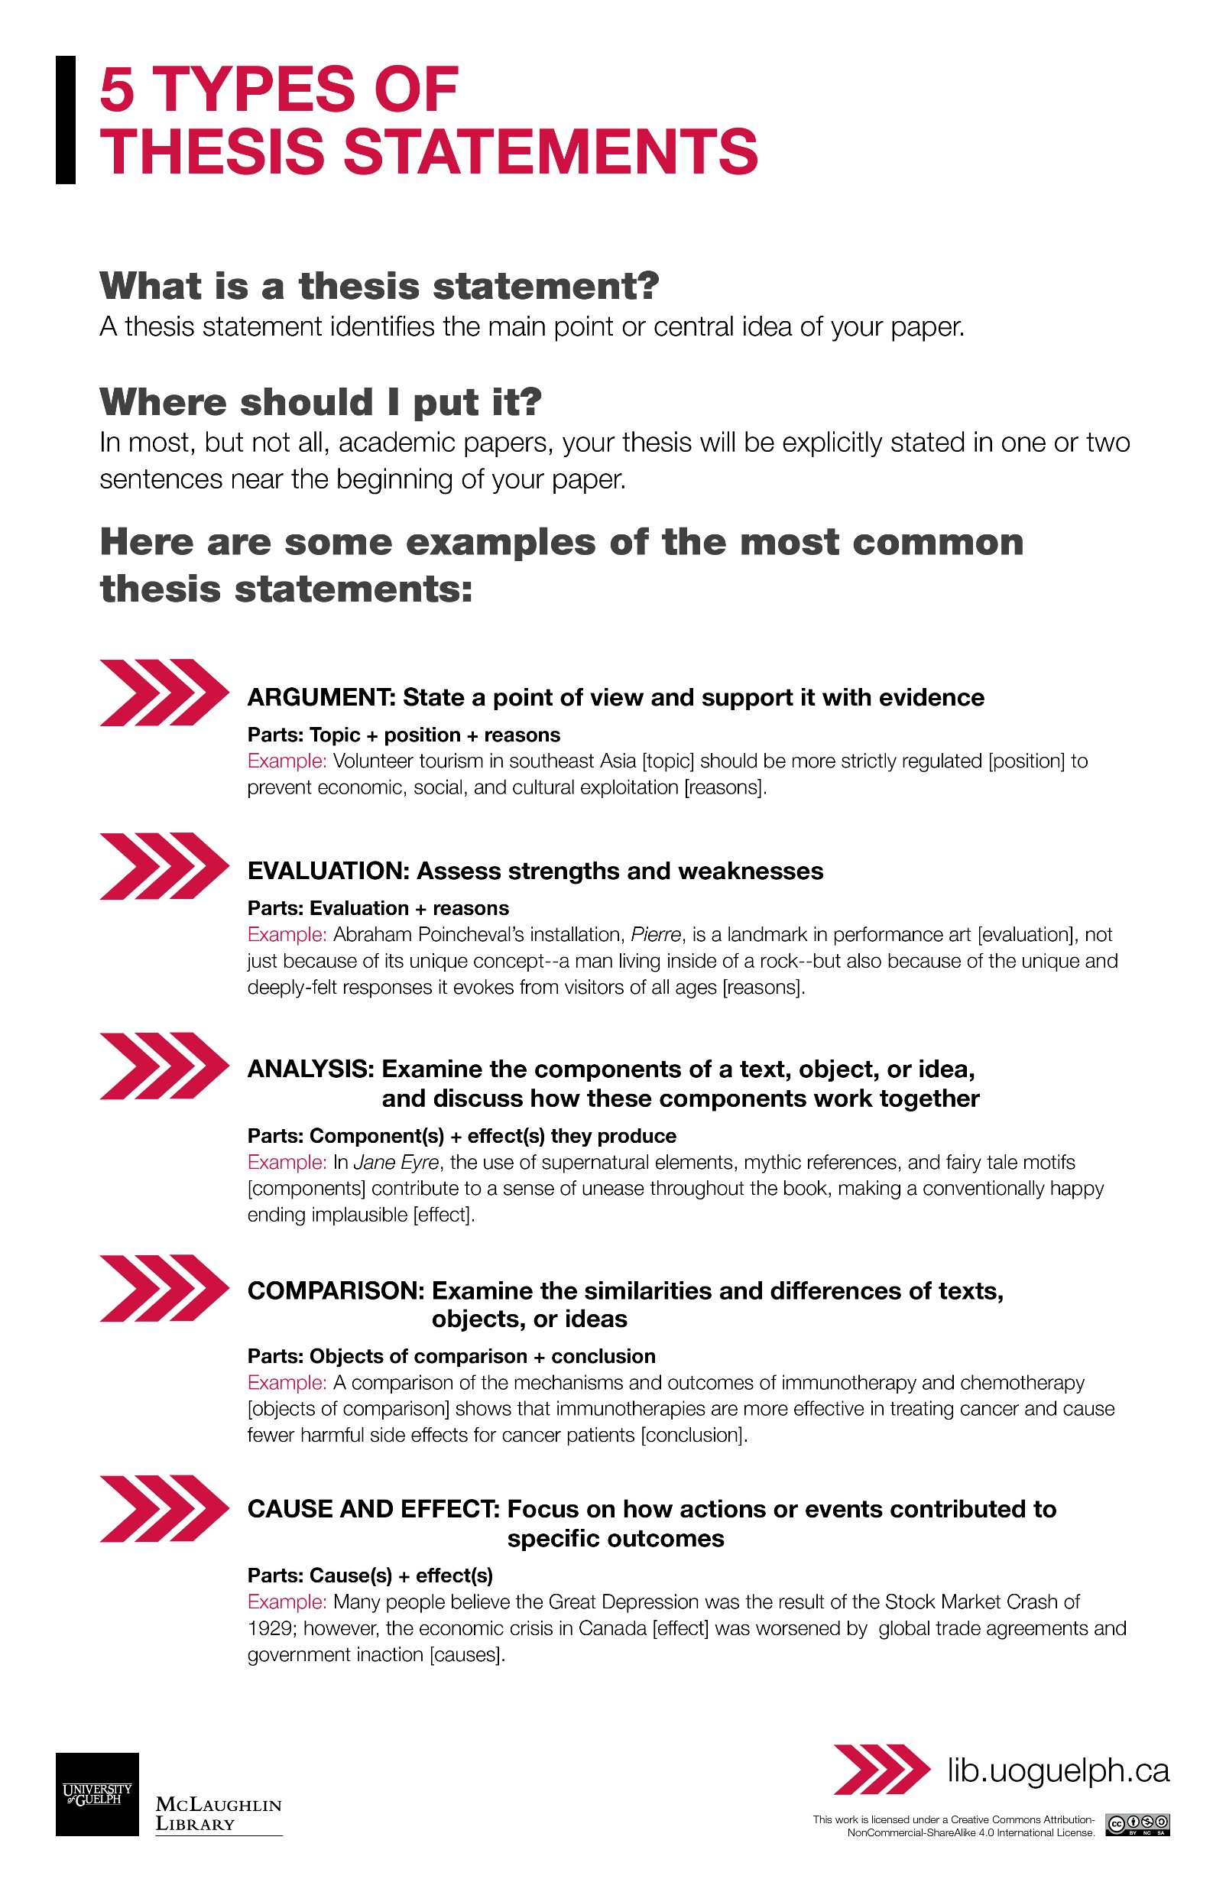
ON THE 5 TYPES OF THESIS STATEMENTS

Slide 13
Identify the Type of Thesis Statement:
Ecological issues arise for these reasons: if there is lack of co-operation among the major nation, if there is uncontrolled exploitation and utilization of resources, or if uncontrolled exploitation of non-renewable resources occur, and contamination of the water.

Slide 14
Answer
This is a cause and effect thesis statement. It identifies the causes or reasons for ecological issues.

Slide 15
How to Identify a Thesis in an Article
According to Chapter 10 of Common Ground, the thesis may be found in a conclusion paragraph or body paragraph in an article.

Slide 16
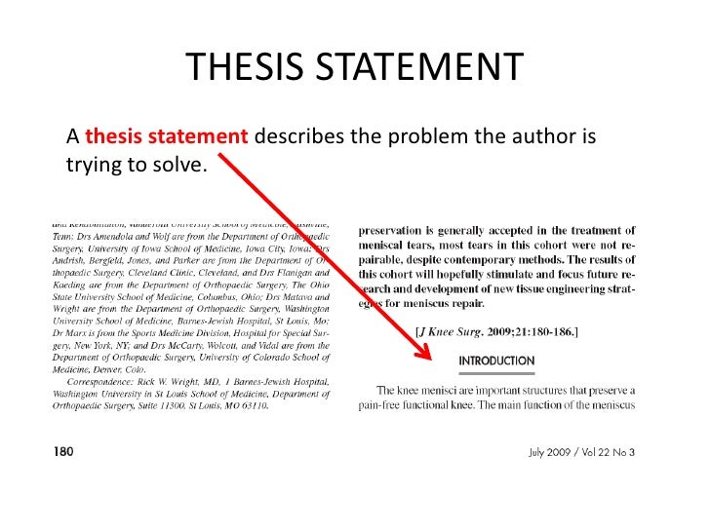
How to Identify the Thesis:

Slide 17
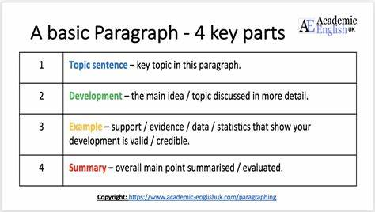
How to Write a Paragraph
A paragraph expresses one main idea, starting with a topic sentence that presents an attention getter that can be an anecdote or a question based on the overall point of the topic that is not specific. There is paragraph development of details in a chronological order needed to lead into a central claim (fact, opinion, or belief), examples and illustrations proving the claim, and a conclusion that sums up the main idea of the paragraph.

Slide 18
How to Write a Well-Written Essay Instructional Video
https://youtu.be/UuOWNNvupik

Slide 19
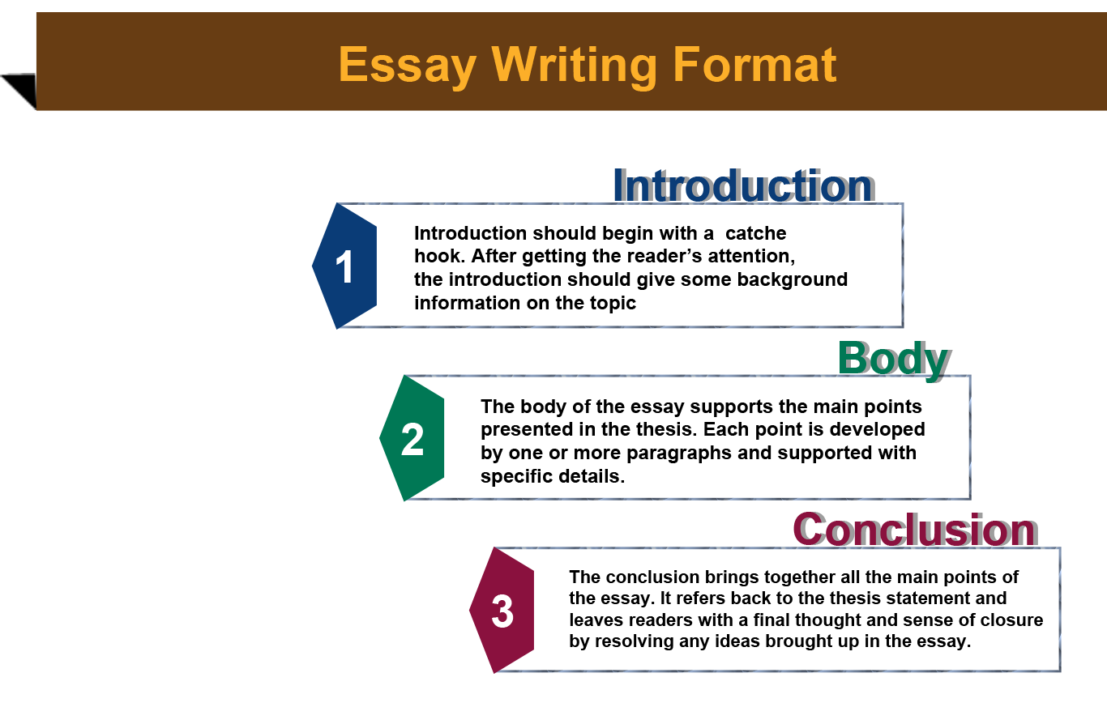
How to Structure an Essay

Slide 20
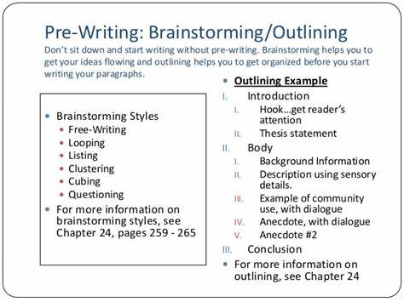
On Pre-Writing/Outlining
Prewrite ideas that you want to possibly write about. Narrow the list and free write or cluster map ideas for one topic. Outline the thesis, topic sentence, central claims, and examples in a chronological order of importance. In the conclusion, sum up the main idea of the paper. Call to action. How can others benefit from the values and life lessons within your paper? Always complete these steps before drafting.

Slide 21

Creating Support from pg. 214
Write your thesis
Prewrite to develop support and frewrite
Circle important ideas and select three or four to be major supporting points
Write a topic sentence for each supporting point
Figure out reasons, explanations for examples for each supporting point
Create a simple outline

Slide 22
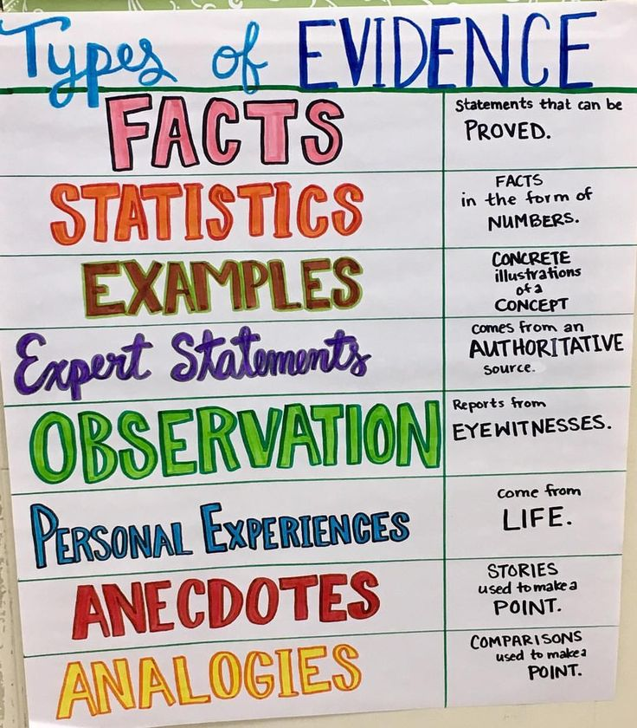
On Finding Supporting Details: Types of Evidence
Types of evidence include case studies (evaluating certain groups or populations), statistics that evaluates certain criteria, examples or illustrations, facts, expert opinion, facts, personal experience, interviews, surveys, anecdotes, analogies, textual evidence, and observation.

Slide 23
On Identifying the Thesis and Supporting Details
Argument Paper, MLA Style (Hammond)
Jamal Hammond Professor
Paschal English
102 17 March XXXX
Performance Enhancement through Biotechnology Has No Place in Sports
The debate over athletes’ use of performance-enhancing substances is getting more complicated as biotechnologies such as gene therapy become a reality. The availability of these new methods of boosting performance will force us to decide what we value most in sports—displays of physical excellence developed through hard work or victory at all costs. For centuries, spectators and athletes have cherished the tradition of fairness in sports. While sports competition is, of course, largely about winning, it is also about the means by which a player or team wins. Athletes who use any type of biotechnology give themselves an unfair advantage and disrupt the sense of fair play, and they should be banned from competition. Researchers are experimenting with techniques that could manipulate an athlete’s genetic code to build stronger muscles or increase endurance.
Searching for cures for diseases like Parkinson’s and muscular dystrophy, scientists at the University of Pennsylvania have created “Schwarzenegger mice,” rodents that grew largerthan-normal muscles after receiving injections with a gene that stimulates growth protein. The researchers also found that a combination of gene manipulation and exercise led to a 35% increase in the strength of rats’ leg muscles (Lamb 13). Opening sentences provide background for Hammond’s thesis. Marginal annotations indicate MLA-style formatting and effective writing. Thesis states the main point. Hammond establishes his credibility by summarizing medical research. Source: Diana Hacker (Boston: Bedford/St. Martin’s, 2007). This paper has been updated to follow the style guidelines in the MLA Handbook for Writers of Research Papers, 7th ed. (2009). Source is cited in MLA style. Source: Diana Hacker (Boston: Bedford/St. Martin’s, 2007). Such therapies are breakthroughs for humans suffering from muscular diseases; for healthy athletes, they could mean new world records in sports involving speed and endurance—but at what cost to the integrity of athletic competition? The International Olympic Committee’s World Anti-Doping Agency has become so alarmed about the possible effects of new gene technology on athletic competition that it has banned the use of gene therapies and urged researchers to devise a test for detecting genetic modification (Lamb 13).

Slide 24
On Identifying the Thesis and Supporting Point.
Argument Paper, MLA Style (Hammond)
Jamal Hammond Professor
Paschal English
102 17 March XXXX
Performance Enhancement through Biotechnology Has No Place in Sports
The debate over athletes’ use of performance-enhancing substances is getting more complicated as biotechnologies such as gene therapy become a reality. The availability of these new methods of boosting performance will force us to decide what we value most in sports—displays of physical excellence developed through hard work or victory at all costs. For centuries, spectators and athletes have cherished the tradition of fairness in sports. While sports competition is, of course, largely about winning, it is also about the means by which a player or team wins. Athletes who use any type of biotechnology give themselves an unfair advantage and disrupt the sense of fair play, and they should be banned from competition. Researchers are experimenting with techniques that could manipulate an athlete’s genetic code to build stronger muscles or increase endurance. *The thesis identifies how athletes who use biotechnology are unethical, appealing to ethos because they give themselves an unfair advantage. It also explains how researchers are experimenting with techniques to build muscle.
Searching for cures for diseases like Parkinson’s and muscular dystrophy, scientists at the University of Pennsylvania have created “Schwarzenegger mice,” rodents that grew largerthan-normal muscles after receiving injections with a gene that stimulates growth protein. The researchers also found that a combination of gene manipulation and exercise led to a 35% increase in the strength of rats’ leg muscles (Lamb 13). Opening sentences provide background for Hammond’s thesis. Marginal annotations indicate MLA-style formatting and effective writing. Thesis states the main point. Hammond establishes his credibility by summarizing medical research. Source: Diana Hacker (Boston: Bedford/St. Martin’s, 2007). This paper has been updated to follow the style guidelines in the MLA Handbook for Writers of Research Papers, 7th ed. (2009). Source is cited in MLA style. Source: Diana Hacker (Boston: Bedford/St. Martin’s, 2007). Such therapies are breakthroughs for humans suffering from muscular diseases; for healthy athletes, they could mean new world records in sports involving speed and endurance—but at what cost to the integrity of athletic competition? The International Olympic Committee’s World Anti-Doping Agency has become so alarmed about the possible effects of new gene technology on athletic competition that it has banned the use of gene therapies and urged researchers to devise a test for detecting genetic modification (Lamb 13).
The types of evidence include statistics (35%) and testimonial evidence from authorities about the possible effects of new gene technology.

Slide 25
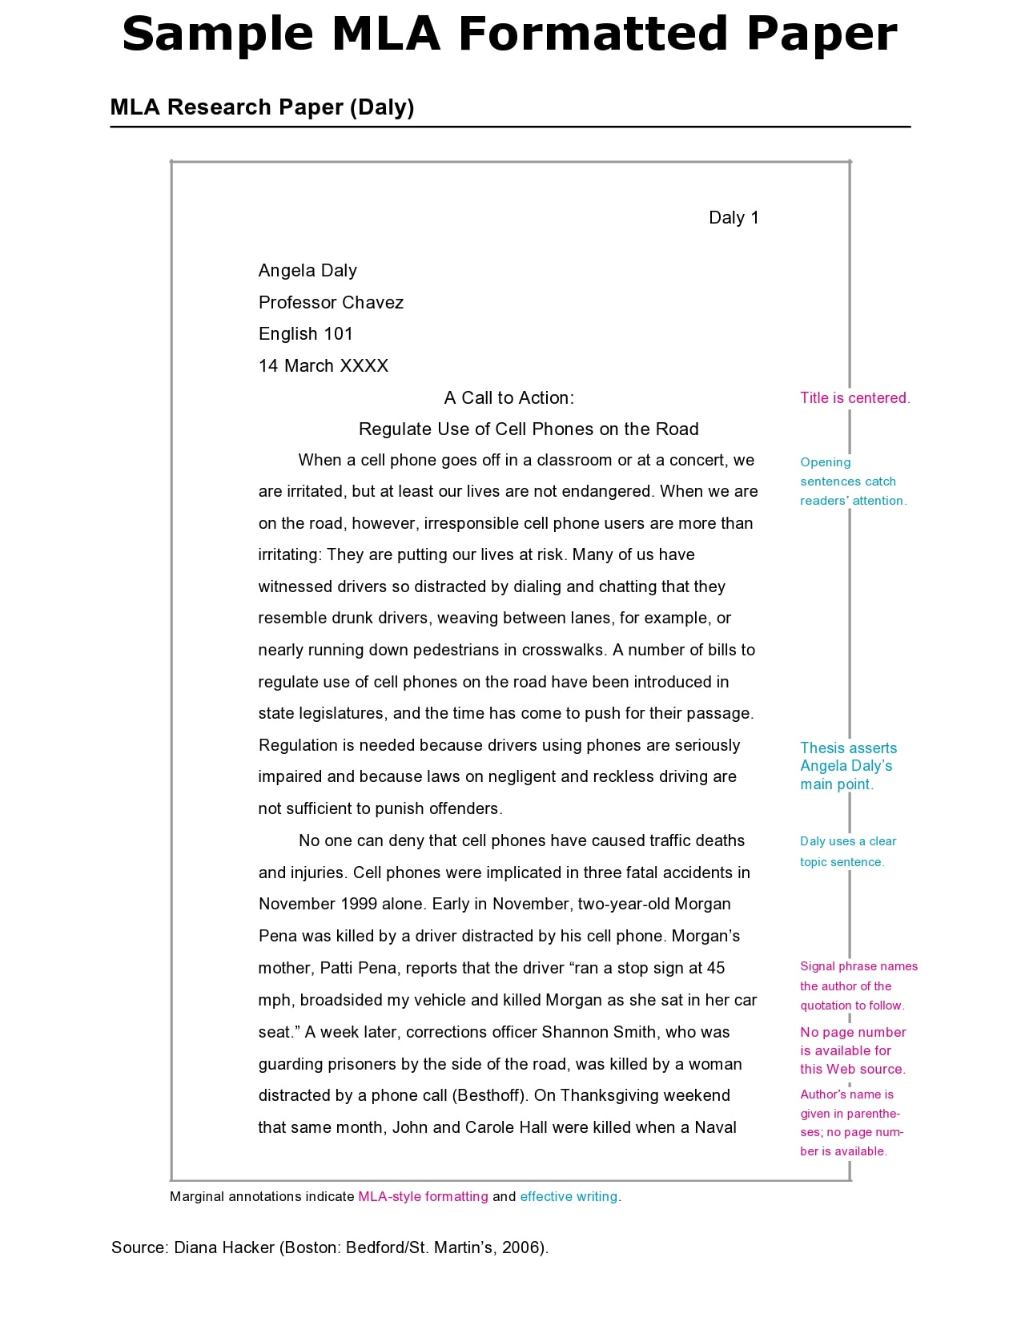
Review Formatting

Slide 26
Reflection
“In your own words, what is an essay?” (228)
“What is the difference between a paragraph and an essay?”
“What is the role of the thesis?”
“What is the role of the paragraph?”

